Slide 1
Byzantine Reliable Broadcast Project
Outline:
Description of the BRB-protocols
Problems encountered and proposed solutions
Simulation settings
Simulation Results
Conclusions

Slide 2
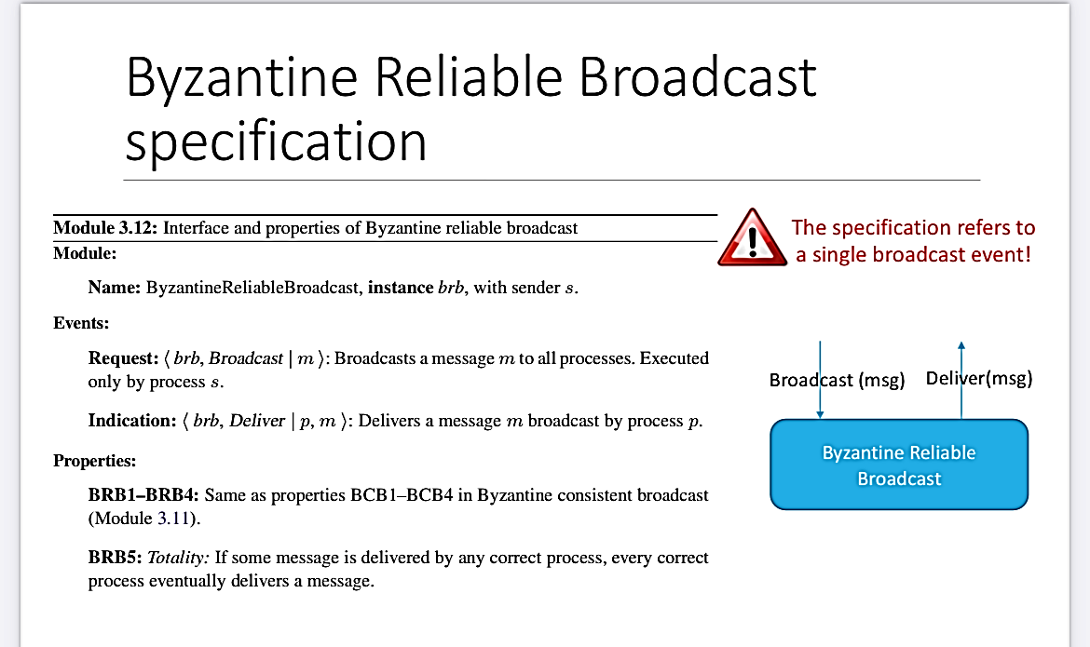
1. Description of the protocols
Properties of BCB:
BCB1: Validity: If a correct process p broadcasts a message m, then every correct process eventually delivers m.
BCB2: No duplication: Every correct process delivers at most one message.
BCB3: Integrity: If some correct process delivers a message m with sender p and process p is correct, then m was previously broadcast by p.
BCB4: Consistency: If some correct process delivers a message m and another correct process delivers a message m’ then m’ = m

Slide 3
Assumptions
Every process knows the ID of the broadcaster that is settled to one in our implementation;
The keys used for authenticated link are read from file created with utils.py
The broadcaster brodacasts the message only to processes that it knew about before the broadcast primitive, so subsequent receivers, that connect to the service afterwards, will not receive it;
The network is fully connected;
The message is considered delivered when the "- - - - -Message Delivered - - - - -" string is prompted in the terminal;
A faulty process is a process that discards every message that it receives after the time it fails or it sends a forged message when the algorithm requires it;
Erasure Code algorithm considers the "source" field of a message instead of the "from" message field for finality and soundness reasons;

Slide 4
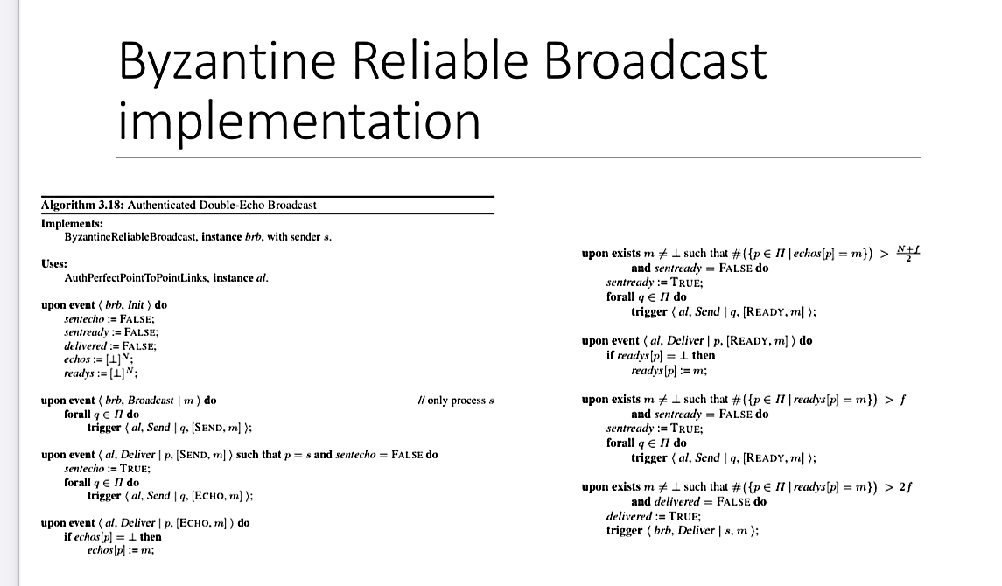
BRB-double-echo pseudocode
Modules:
Authenticated Link
BRB Process

Slide 5
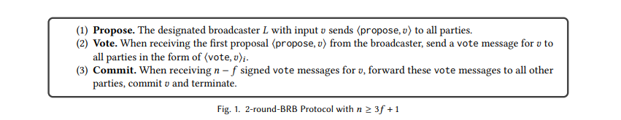
Authenticated Messages Pseudocode
Modules:
Link → used for the vote message phase
Authenticated Link → used for the propose message phase
BRB Process → module that characterizes the protocol implementation
Server(s) → server for process identification

Slide 6
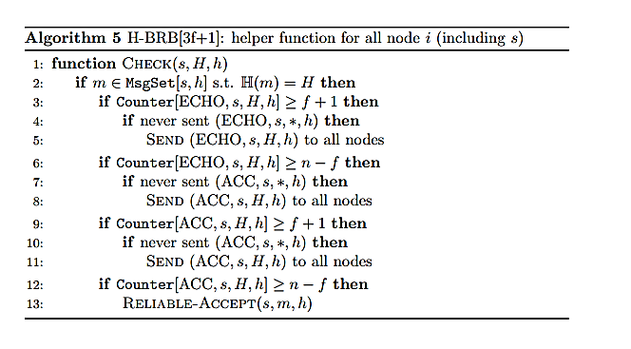
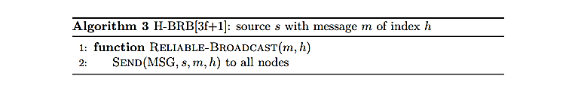
Hash Based Pseudocode
Modules:
BRB Process
Authenticated link

Slide 7
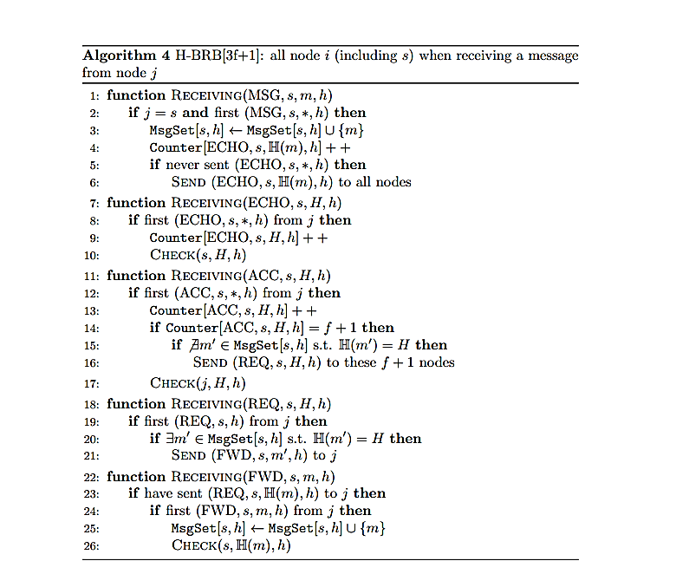
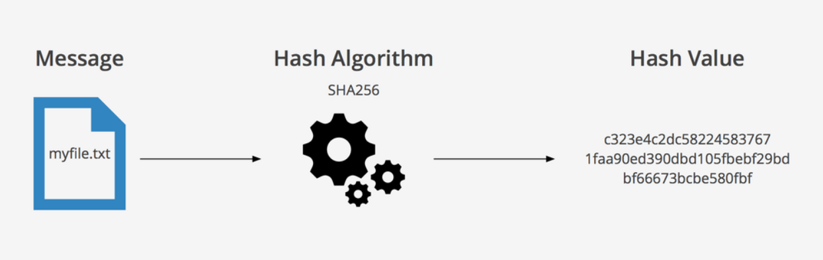
Hash Based Pseudocode
For each message flag a different receiving functions
Message identified by (source,SN) tuple
For each message flag a different counter
Counter indexed on the key (flag,source,Hash(m),SN)
Check function to verify if some type of counter exceed a bounded threshold to take the required actions
Hashing used → SHA256

Slide 8
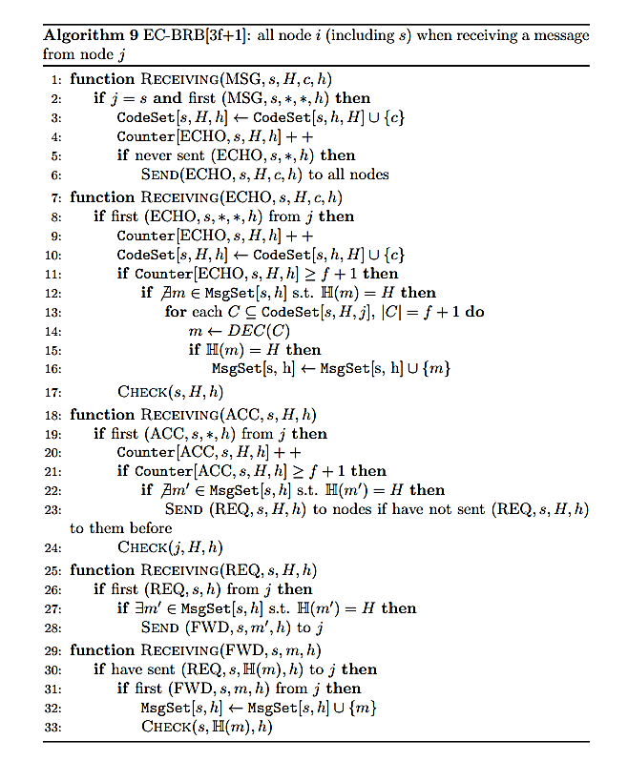
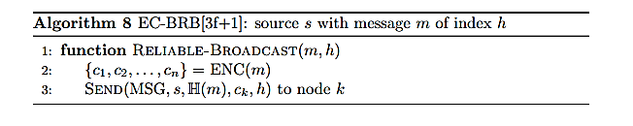
Erasure coding pseudocode
Modules:
BRB Process
Authenticated link

Slide 9
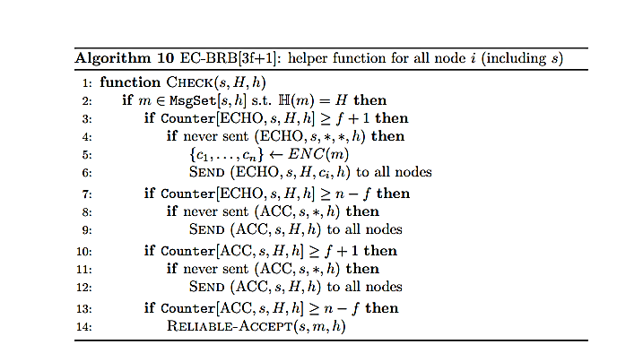
Erasure coding pseudocode
Similar to the others specifications we have the reliable broadcast primitive
The message is divided into fragments
Different receiving functions for each flag
Check function similar to the HB one
Counter structures similar to the HB ones
Codeset indexed on tuple (source,H(m),SN)

Slide 10
2. General problems encountered and solutions
Not very familiar to the simulation tools
Few documentation for the encryption functions
Difficult to find a suitable python library for MDS-Erasure Code
Difficult to decide between robustness of the protocol and efficiency
Difficult to manage links module implementation and APIs
Difficult to code from scratch the suitable links module implementation
Not always clear stated some features and steps of the protocols pseudocode
Difficult to set up a basic benchmarking to debug
Limit to the SW/HW resources

Slide 11
3. Simulation settings
In the simulation of the four protocol we have considered the following metrics to evaluate them:
Average elapsed time of the protocol;
Average memory usage;
Average bandwidth.
Star topology: N hosts connected to 1 switch
Processes from 4 to 20
Payload from 256 to 2048
Bandwidth from 500KBPS to 1GBPS.

Slide 12
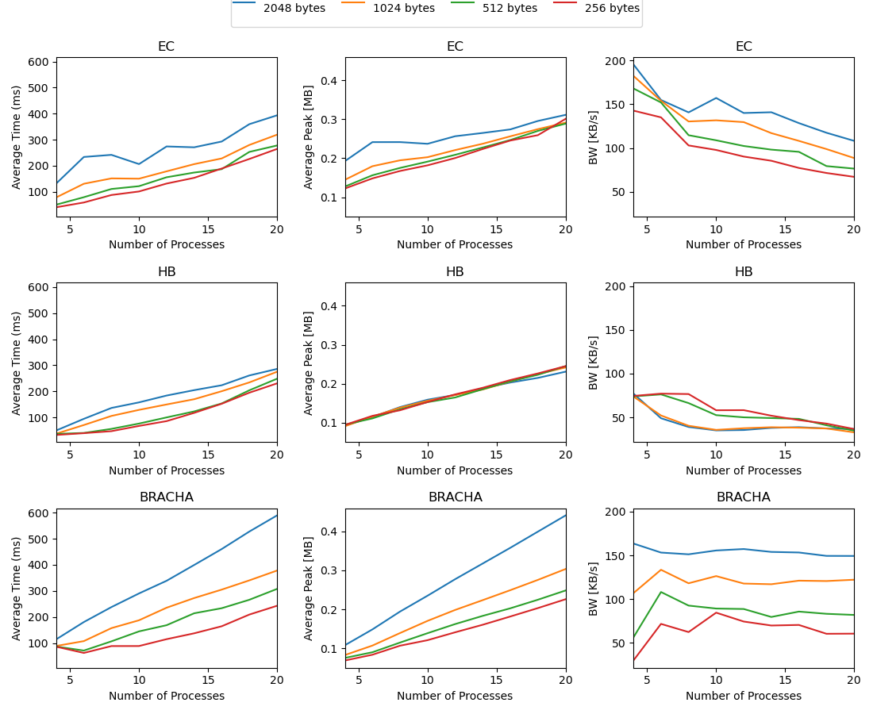
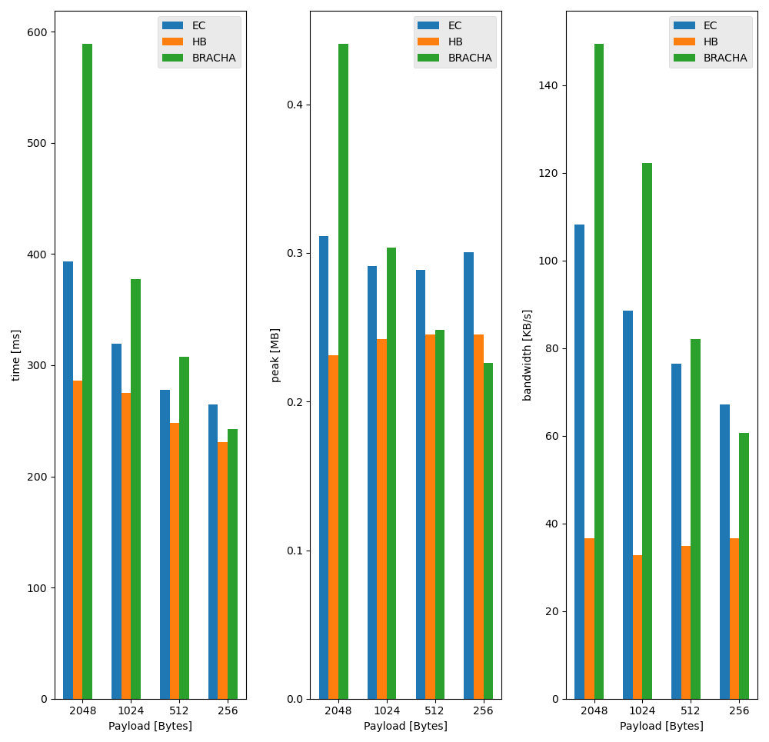
4. Simulation results (N = 20, payload = {256,512,1024,2048})
BW= 2MBPS

Slide 13
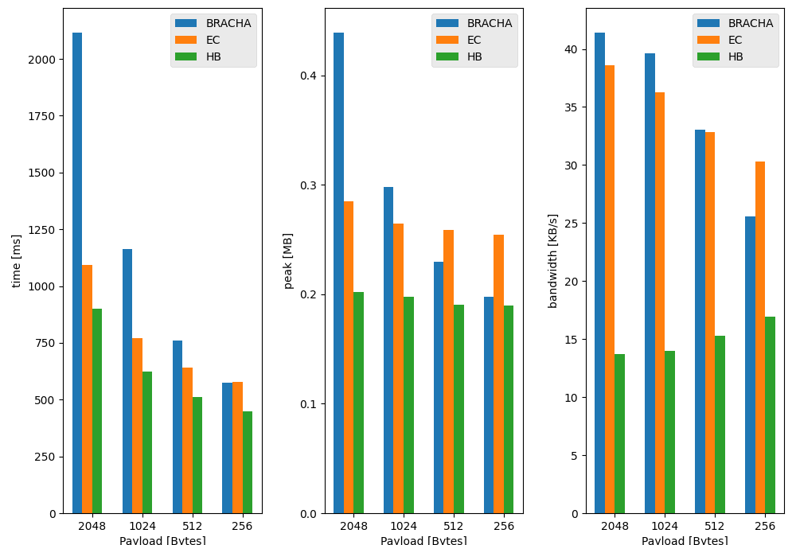
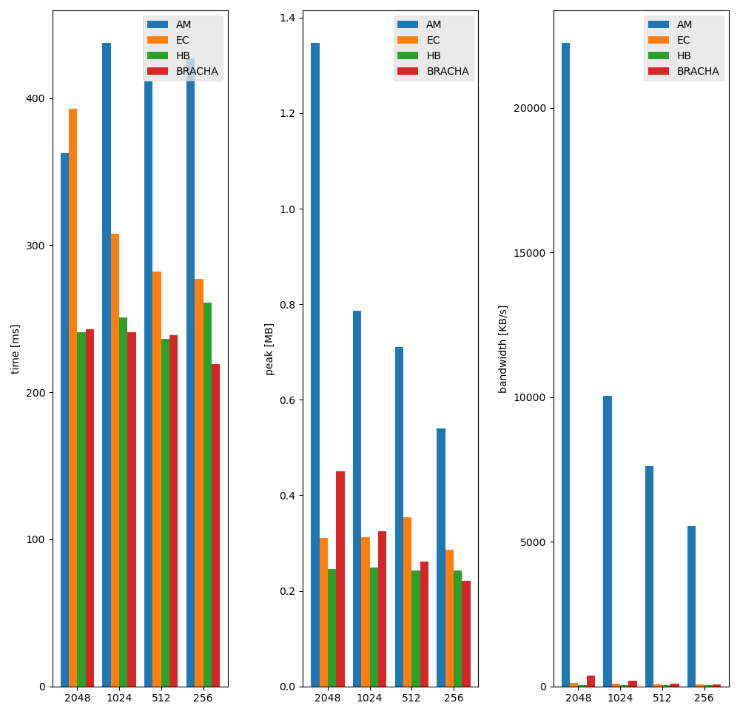
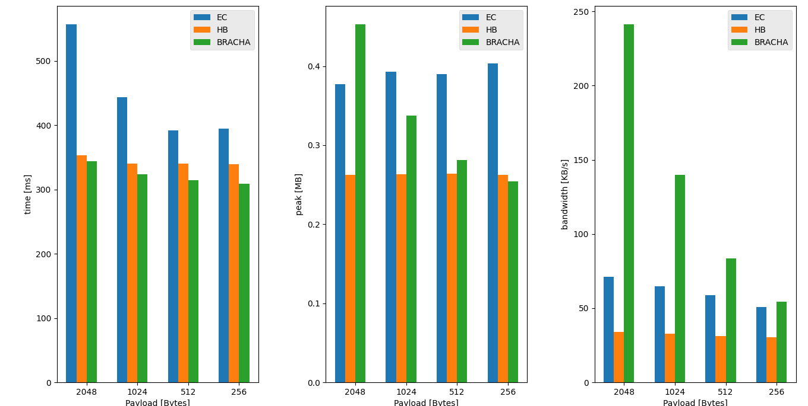
500KBPS
1GBPS
10MBPS

Slide 14
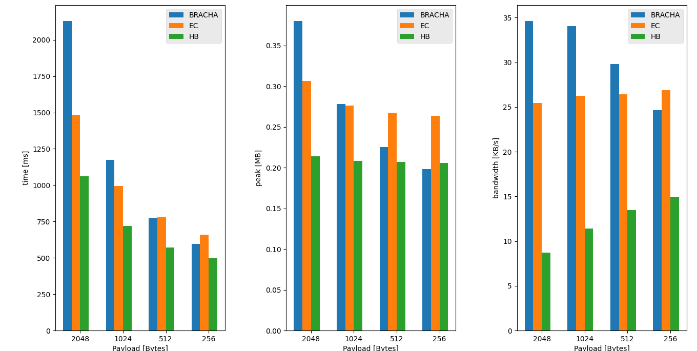
6BYZ-500KBPS
6BYZ-10MBPS

Slide 15
5. Conclusions
HB better than EC but we expect that with a lot of processes EC is better
Bracha can be used with high bandwidth and small payloads
AM is not comparable due to the usage of cryptographic primitives and latency for the KDS
Our analysis is only for N = 20, with more processes results can change

Slide 16
Byzantine Reliable Broadcast Project
● Number of group members: 3
● Members: Gianmarco Bordin, Carlo Giralda, Gabriele Lerani
● Student IDs: 2081387, 1903088, 2093689

